Slide 1
How to write blog like an old school journalist
Bill Bennett

Slide 2
What is journalism?:

Slide 3
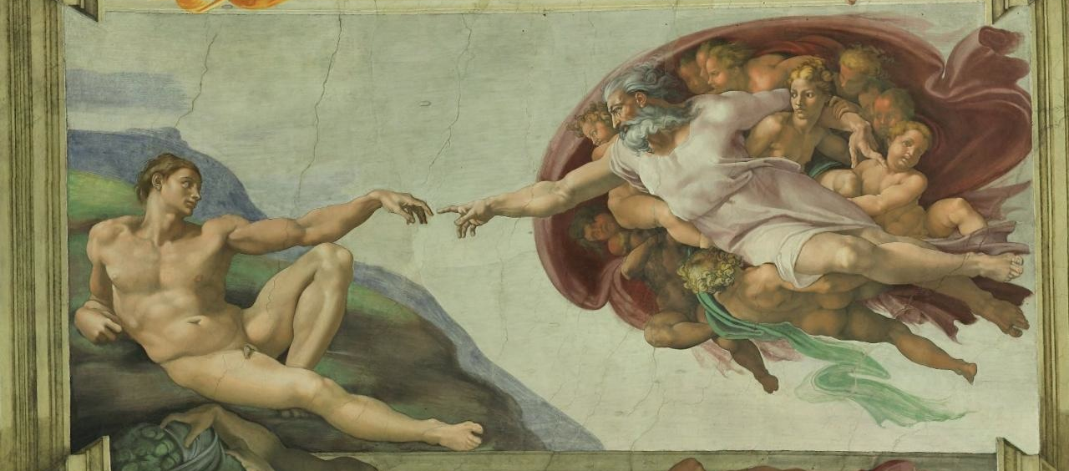
Tell me something I don’t know
What else is journalism?:

Slide 4
It’s all about me, my experience
Blogging:

Slide 5
How to blog like a journalist:
Get started straight away
Begin by telling readers what the post is about
Inverted pyramid
Write so the material could be cut at any point and readers still have the maximum information

Slide 6
How to blog like a journalist:
Write clearly, use understandable language, be unambiguous
Use simple words, grammar and sentences
Prefer Anglo-Saxon words to French or Latin ones

Slide 7
How to blog like a journalist:
Go easy on adjectives and adverbs
Use lots of full stops
Keep sentences short, less that 20 words where you can. Less than 15 words is better
Paragraphs should be three or four sentences: 40 to 50 words

Slide 8
How to blog like a journalist:
Aim to write short, crisp posts
“I would have written a shorter letter, but I did not have the time.” Most people think it was Mark Twain; it was Blaise Pascal, a French Mathematician.
Readers tire at 200 words and drop out at 300. Prefer this length, but experiment with longer ones too

Slide 9
How to blog like a journalist:
Try to picture your reader while you are writing
Write it as if you were talking to them

Slide 10
How to blog like a journalist:
Avoid: - ‘Be’ words - Exclamation marks! - Cliches - Overdoing ‘chatty’ - Words in CAPITALS

Slide 11
How to blog like a journalist:
Learn grammar
Spell check
If possible get someone else to read before posting

Slide 12
Writing is story telling
How to blog like a journalist:

Slide 13
Questions
How to blog like a journalist

Slide 14
billbennett.co.nz @billbennettnz

